Slide 1


NUS-ISS-ISY5002-PRS-PracticeModule
MarineVision
Advanced Deep Learning Techniques to Enhance Underwater Video Footages for Improved Marine Object Identification
Ashiwin Rajendran (A0291191E)​
Jithin Krishnan (A0249481W)​
Prem Varijakzhan (A0291913B)​
Shankar Sai Ganesh (A0168149U)​

Slide 2
Project Background
Background
Underwater environments cause visual issues like light attenuation, colour distortion, and scattering, affecting image clarity and object detection.
Above is particularly problematic in areas such as marine research, conservation, and underwater exploration, where clear and precise visual data is essential.
BeeX specializes in autonomous underwater robotics for critical infrastructure, requiring high-quality video data for precise analysis and maintenance.

Slide 3
Project Objective
Objective
Develop an advanced underwater image enhancement system using GANs, CNNs, and ensemble models.
Deliver enhanced video quality through a web interface for underwater exploration.
Scope
To develop a web application that allows users to upload underwater videos, which are processed frame-by-frame, ensuring efficient enhancement.
Frames are passed through various pretrained deep learning models (e.g., GANs, CNNs) to correct lighting, contrast, and colour distortions.
The enhanced frames are converted back into a video format for the clients use for further analysis

Slide 4
Current Techniques / Challenges
Current Techniques
Traditional methods like ICM, UCM, and RGHS target specific underwater image issues such as color correction, low contrast, and light attenuation.
ICM: Focuses on color balance and brightness correction.
UCM: Enhances image sharpness by highlighting edges and fine details through the subtraction of a blurred version from the original image.
RGHS: Improves image contrast and color consistency by applying Retinex theory with histogram stretching to address varying illumination.
These methods are effective for isolated problems but lack the ability to address multiple issues simultaneously.
Many deep learning models are trained on datasets enhanced with these techniques, but they tend to be biased toward specific improvements (e.g., contrast or light filtering), making them less versatile in diverse underwater scenarios.
Challenges
Light attenuation and color distortion: Different wavelengths are absorbed at varying depths, causing unnatural color casts that are difficult to correct, especially with changing water clarity and lighting.
Light scattering by water particles: Causes blurriness and low contrast, which are tough to handle with specific traditional methods.
Lack of high-quality labeled data: Limits the effectiveness of supervised models, leading to reliance on self-supervised learning and synthetic datasets, which often struggle to generalize to real-world scenarios.
Over-specialization of current techniques: Most methods are too focused on specific problems, failing to adapt to the diverse and complex conditions found in underwater environments.
There is a need for a holistic and flexible approach that can address the above varying underwater conditions more effectively, thereby making a more robust and generalized image enhancement model

Slide 5
Data Requirements and Availability
Required:
Images captured by the company's marine robots for use in training and testing the image enhancement models.
Paired underwater scene images (raw and corresponding enhanced versions) for training GAN models, enabling the system to learn from distorted and improved image pairs.
Available:
Publicly available EUVP dataset (https://irvlab.cs.umn.edu/resources/euvp-dataset), providing paired underwater images for initial model training.
Underwater images collected by the client's marine robots, offering real-world data for fine-tuning and testing to ensure optimal performance in practical applications.

Slide 6
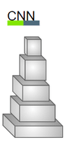
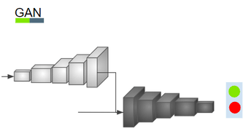
Machine Learning Algorithms
CNN-Based Models
Purpose: Image enhancement tasks like denoising, deblurring, and contrast improvement.
Training: Uses paired data of original and enhanced frames with loss functions like MSE or perceptual loss.
GAN-Based Models
Purpose: Enhance underwater frames by learning mappings between low-quality and high-quality frames.
Training: Uses adversarial loss and cycle consistency loss to improve visual fidelity.
Image Source: Uřičář, Michal & Krizek, Pavel & Hurych, David & Sobh, Ibrahim & Yogamani, Senthil & Denny, Patrick. (2019). Yes, we GAN: Applying Adversarial Techniques for Autonomous Driving.
Notes:
For our Underwater image enhancement; we had particularly chosen two neural network based models which is CNN and GAN. CNN Extracts spatial hierarchies in images through convolutional layers, making it effective for tasks like denoising, deblurring, and contrast enhancement and they are great at learning local patterns (like edges and textures). GAN models Generates new, realistic images by learning the mapping between low-quality and high-quality images. GANs leverage adversarial loss, where a generator and discriminator compete, leading to highly detailed and visually coherent image enhancements.

Slide 7
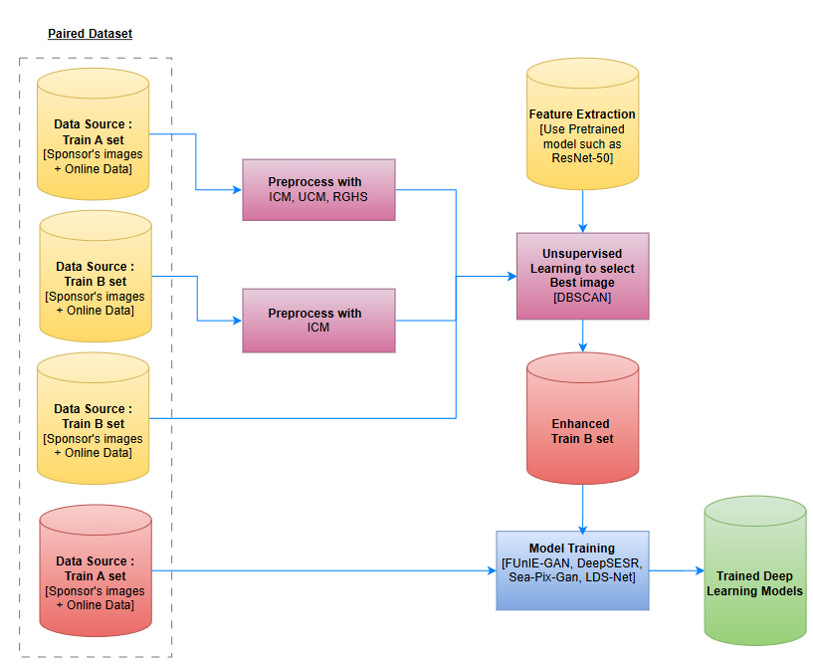
Modelling Flow
Notes:
Here is the modelling flow where I will be saying a brief concept and idea on how the data is used for training the model.
Data Source: Two sets, Train A and Train B, include sponsor's images and online data.
Preprocessing: Apply enhancement techniques like ICM, UCM, and RGHS on Train A to improve image quality, fusion approach of enhancing the enhanced images through ICM, and the given train B set
Unsupervised Learning: The five preprocessing image methods will be going through unsupervised learning method to select the best image or enhanced train B set. Methods like DBSCAN are used to select the best images.
Feature Extraction: Pretrained models like ResNet-50 extract high-level features.
Training: Models like FUnIE-GAN, SeaPixGan, LDS-net and Deep sesr models are trained to enhance images.

Slide 8
Data Preprocessing
Underwater Image Enhancement Techniques
ICM (Improved Color Model)
The Improved Color Model (ICM) is a color-based enhancement method designed to correct image brightness, contrast, and saturation issues
ICM often uses color space transformation (e.g., from RGB to YUV/HSV color space) to separate luminance and chrominance components
UCM (Unsharp Masking Contrast Enhancement):
Unsharp Masking Contrast Enhancement (UCM) is a classic technique used to improve image sharpness and contrast.
UCM utilizes a Gaussian blur to create a softened version of the image and then sharpens the image by adding back the high-frequency components
RGHS (Retinex Guided Histogram Stretching):
RGHS combines principles from Retinex theory with histogram stretching to enhance image contrast and color details.
It is aimed at addressing illumination variations in an image.
It enhances both the local contrast and maintains color consistency by mimicking how humans perceive light and shadows.
Feature Extraction with ResNet
ResNet Architecture: Utilize a pre-trained ResNet model to extract high-level features related to image quality. Layers capture different aspects of image quality, including sharpness, contrast, and brightness.
Sharpness: Detects edges and fine details.
Contrast: Captures intensity differences.
Brightness: Measures overall light intensity.
Notes:
As mentioned we are coming up with five preprocessing approaches and from that we select the best images for enhanced train B set.
We are using
Image Enhancement Techniques:
ICM: Adjusts brightness, contrast, and color distortion using color space transformations.
UCM: Sharpens images by enhancing edges and details.
RGHS: Combines Retinex theory and histogram stretching to correct illumination and color.
Feature Extraction with ResNet:
ResNet layers capture sharpness, contrast, and brightness, providing high-level features for downstream tasks.

Slide 9
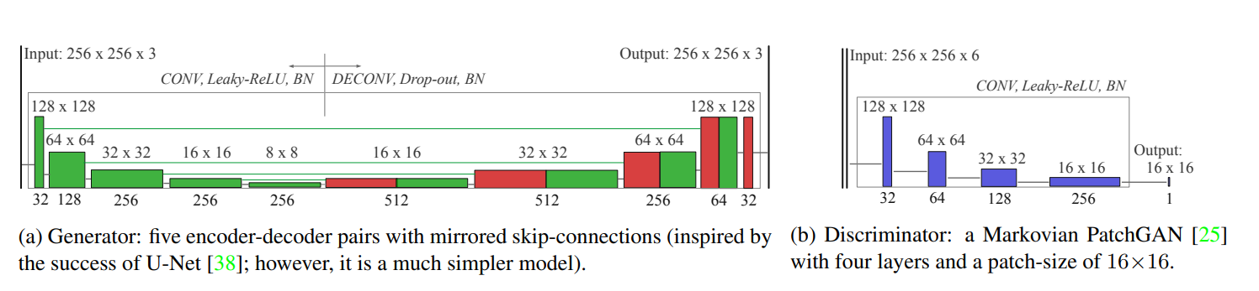
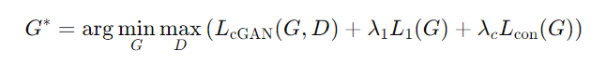
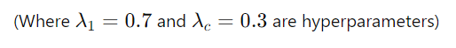
Image Enhancement Model – FunieGan
FUnIE-GAN (Fast Underwater Image Enhancement using GAN) is a deep learning model designed for enhancing distorted images, particularly underwater images, into visually enhanced outputs. It leverages the power of Generative Adversarial Networks (GANs) to achieve fast and efficient image-to-image translation
Goal: Learn a mapping G:X→Y from distorted images (domain X) to enhanced images (domain Y).
Architecture:
Generator: U-Net-based encoder-decoder with skip connections (256x256x3 input/output). Fully convolutional, optimized for fast inference with 4x4 convolutions, Leaky-ReLU, and Batch Normalization.
Discriminator: PatchGAN architecture focusing on local patch-level details (16x16 patches) to ensure texture and style consistency.
Loss Functions:
Adversarial Loss: Standard GAN objective for image realism.
L1 Loss (Global Similarity): Enforces global similarity between generated and real images.
Content Loss: Encourages high-level feature representation similarity using a pre-trained VGG-19 network.
PatchGAN Loss: Captures local texture and style details.
Training Objective:
Image Source: Islam, M. J., Xia, Y., & Sattar, J. (2020). Fast Underwater Image Enhancement for Improved Visual Perception. IEEE Robotics and Automation Letters
Notes:
Goal: Map low-quality underwater images to high-quality versions using GAN-based image-to-image translation.
Generator: U-Net based, optimized for fast inference.
Discriminator: PatchGAN, which focuses on texture consistency.
Loss Functions: Includes adversarial loss, L1 loss (for global similarity), content loss (to retain structure), and PatchGAN loss.
Training Objective: Minimize GAN loss while balancing other losses to produce realistic, high-quality images.

Slide 10
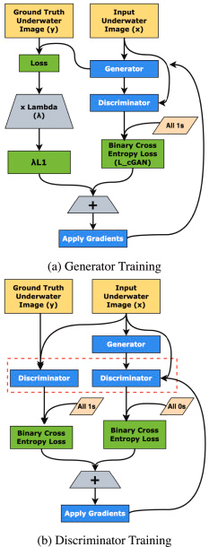
Image Enhancement Model – Sea-Pix-Gan
Sea-Pix-GAN is a deep learning model designed to enhance underwater images by addressing challenges like poor visibility, colour distortions, and lack of contrast.
Key Components:
Input Image (x): Low-quality underwater image needing enhancement.
Ground Truth Image (y): High-quality reference image for training.
Generator:
Enhances low-quality images to match the high-quality reference.
Uses a U-Net-like architecture to capture fine details and high-level features.
Trained with adversarial loss (L_CGAN) and L1 loss for realism and fidelity.
Discriminator:
Distinguishes between real high-quality and generated images.
Provides feedback to improve the generator.
Challenges Addressed:
Lighting: Compensates for inconsistent underwater lighting conditions.
Colour Restoration: Restores distorted/lost colours due to light scattering.
Detail Preservation: Sharpens and clarifies images for better marine object visibility.
Image Source: Chaurasia, D., & Chhikara, P. . Sea-Pix-GAN: Underwater
image enhancement using adversarial neural network.
Notes:
raining Process:
(a) Generator Training:
Generator produces enhanced images.
Loss = L1 (pixel-wise difference) + Adversarial loss.
Gradients applied to update generator weights.
(b) Discriminator Training:
Trains to classify real images as real (1s) and generated as fake (0s).
Feedback refines the generator’s performance.

Slide 11
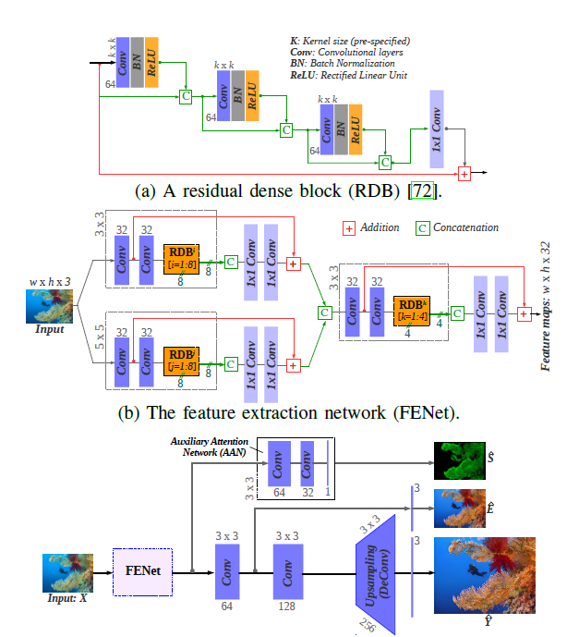
Image Enhancement Model - Deep SESR
Deep SESR (Simultaneous Enhancement and Super-Resolution) is an advanced generative model designed to improve the visual quality of underwater images by enhancing and increasing their resolution simultaneously. Developed for visually-guided underwater robots, Deep SESR addresses the unique challenges of underwater environments, such as optical distortions, low contrast, and blurriness.
Architecture
Residual Dense Blocks (RDBs): The core building blocks of the model, RDBs use densely connected convolutional layers to capture detailed features and ensure effective learning of image enhancement.
Feature Extraction Network (FENet): A two-stage feature extraction network that processes input images through multiple RDBs. It learns to extract rich features at different scales to enhance contrast, sharpness, and color fidelity
Auxiliary Attention Network (AAN): An additional network that predicts saliency maps, highlighting important regions in the image to guide the enhancement process. Helps focus computational efforts on areas of the image that are most relevant for visual perception.
Upsampling Layers: These layers increase the resolution of the enhanced image, performing super-resolution. The architecture allows flexibility in generating high-resolution outputs tailored to specific application needs.
Multi-Modal Objective Function: Guides the training process with a combination of loss functions targeting chrominance correction, sharness improvement, and overall image quality enhancement.
Image Source: Islam, M. J., Luo, P., & Sattar, J. (2020). Simultaneous Enhancement and Super-Resolution of Underwater Imagery for Improved Visual Perception. Robotics: Science and Systems

Slide 12
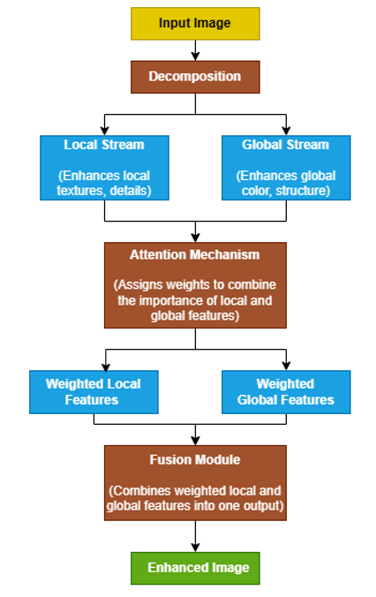
Image Enhancement Model -LDS-Net
The LDS-Net is a CNN based enhancement techniques apt for underwater image enhancement due to its component-based enhancement approach. It is specifically designed to handle the types of challenges encountered in underwater images, such as lighting distortion, color imbalance, and noise
Key Components of LDS-Net:
Dual-Stream Architecture:
Local Stream: This stream focuses on enhancing the local features in the image, such as textures, edges, and fine details. It uses convolutional layers to capture spatial details and contrast enhancement.
Global Stream: This stream processes the overall structure and global illumination of the image. It looks at the larger context, balancing brightness, color, and correcting color distortions across the entire image.
Attention Mechanism:
LDS-Net uses an attention mechanism to combine the outputs of the local and global streams. The attention mechanism helps the model to focus on important regions in the image by assigning weights to different parts of the image, balancing local and global enhancements intelligently.
Fusion Module:
After processing by the local and global streams, the features from both streams are combined using a fusion module. This fusion is key to synthesizing both detailed local corrections and global enhancements into a single output. It takes the weighted outputs from both streams and blends them to form a single enhanced image. It ensures that both local and global enhancements complement each other.
LDS-Net Architecture
Notes:
LDS-Net is a CNN-based model designed to enhance underwater images by addressing challenges like lighting distortion, color imbalance, and noise.
LDS-Net is highly effective for our problem because it directly tackles these common underwater image issues. Its dual-stream architecture ensures both fine details (textures and edges) and the overall image quality (color and brightness) are enhanced, resulting in sharper and more natural images. The attention mechanism intelligently focuses on the most important parts of the image, ensuring precise corrections where needed. Finally, the fusion module combines these enhancements, creating a well-balanced, clear, and visually appealing image.
The diagram on the right illustrates how LDS-Net works. The input image is first decomposed into two streams: the Local Stream, which enhances fine details like textures and edges, and the Global Stream, which corrects overall color and brightness. Both streams' outputs are processed through an Attention Mechanism, which assigns weights to balance local and global enhancements. These weighted features are then combined in the Fusion Module, resulting in a final enhanced image that is clear, color-balanced, and detailed.

Slide 13
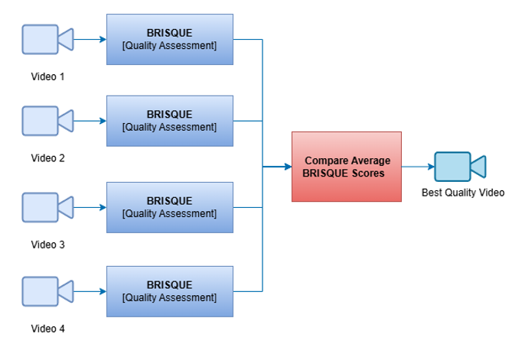
Best Video Selection
BRISQUE (Blind/Referenceless Image Spatial Quality Evaluator) assesses the quality of video frames without needing a reference video. The BRISQUE model comes embedded in libraries such as pybrisque can used it directly without additional training or data
Methodology:
BRISQUE Evaluates each frame based on Natural Scene Statistics (NSS), identifying how much a frame deviates from a high-quality natural image.
Each video is processed frame-by-frame through BRISQUE to calculate a quality score.
These scores are averaged across all frames to provide an overall quality score for the entire video.
The video with the lowest average BRISQUE score is considered the best quality video.
This method allows for quick, no-reference evaluation of video quality based on perceptual characteristics.
Notes:
In our video selection process, we use BRISQUE (Blind/Referenceless Image Spatial Quality Evaluator) to determine the best-quality video. BRISQUE assesses the quality of each video frame by analyzing its Natural Scene Statistics—no reference video or additional training data is required. For each video, BRISQUE calculates a quality score for every frame, and these scores are averaged to provide an overall quality score for the entire video. The video with the lowest BRISQUE score is selected as the best-quality video. This method allows us to quickly and efficiently evaluate video quality without needing a reference, ensuring we select the most visually appealing video.

Slide 14
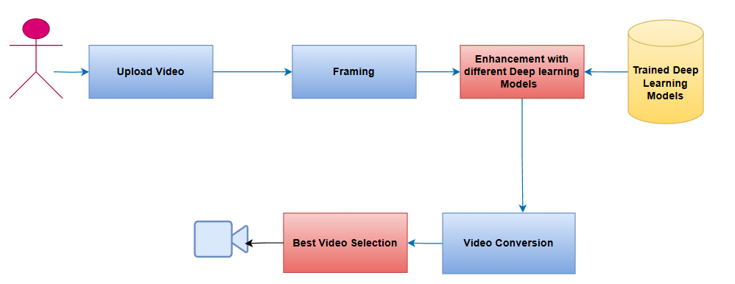
Application Workflow
Notes:
In our video processing pipeline, the user first uploads a video, which is then broken down into frames through the framing process.
These frames are enhanced using various deep learning models trained to improve visual quality as explained by my collogues earlier .
After enhancement, the system performs best video selection by evaluating the output of each model to determine which enhanced version has the highest quality.
Finally, the best-quality video is processed for video conversion and prepared for output.
This automated approach ensures that we select and deliver the best possible video based on deep learning enhancements.

Slide 15
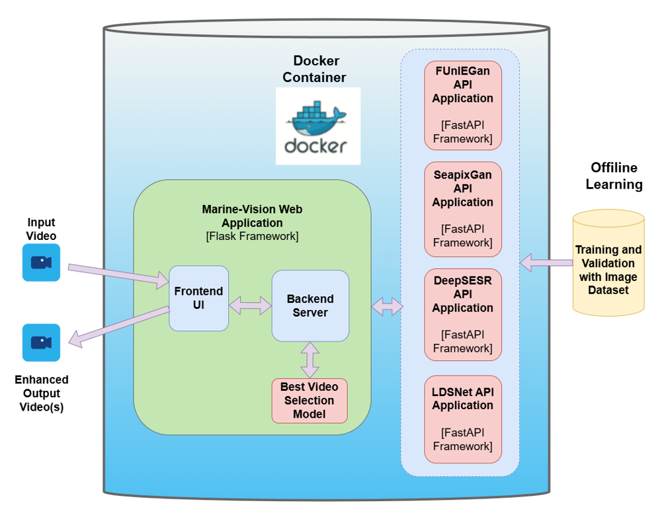
System Design
Notes:
In this system design, input videos are processed through a Marine-Vision Web Application built with the Flask framework.
The web app consists of a Frontend UI and a Backend Server, which handles the best video selection using a trained model.
The application is containerized using Docker to ensure a scalable and isolated environment.
For video enhancement, the backend communicates with multiple API applications running in the Docker container, such as FUNIE-GAN, SeaPixGAN, DeepSESER, and LDSNet, all built on the FastAPI framework.
These APIs enhance the videos based on different models.
Offline learning is performed with image datasets to continuously train and validate these models. The result is enhanced output videos, which are delivered back to the user through the system.

Slide 16
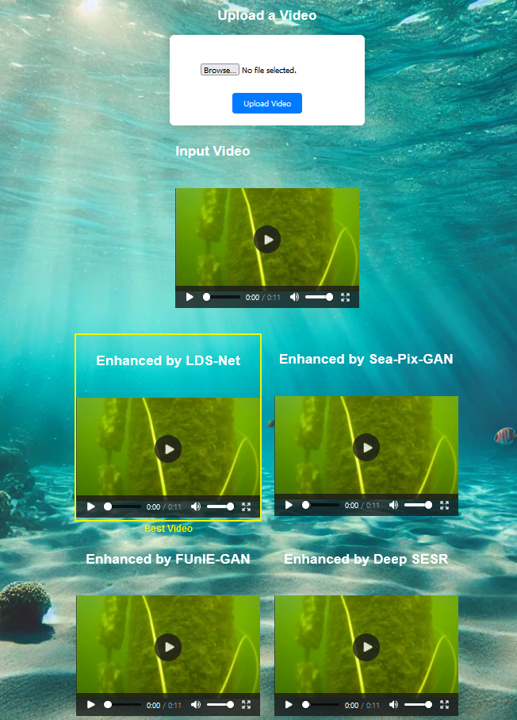
Progress
What is done so far:
Data Preparation and Preprocessing : Data collection, cleaning, and transformation tasks have been completed
Initial training and valuation of Enhancement models : Successfully trained and evaluated the initial version of the enhancement models.
Overall Application Architectural implementation : Implemented the foundational architecture of the application.
In Progress:​
Deeper Training and Fine-Tuning of Models : Further refinement and optimization of models are required for improved performance.​
Integration of Models into the Main Application : The next step is to integrate the trained models into the main application framework.
Notes:
So far, we’ve completed the data preparation and preprocessing stages, which involved data collection, cleaning, and transformation.
We’ve also successfully conducted the initial training and evaluation of our enhancement models, and the overall application architecture has been implemented.
Moving forward, our focus will be on deeper training and fine-tuning of the models to improve their performance.
Additionally, we need to work on the integration of the trained models into the main application framework to complete the system.

Slide 17
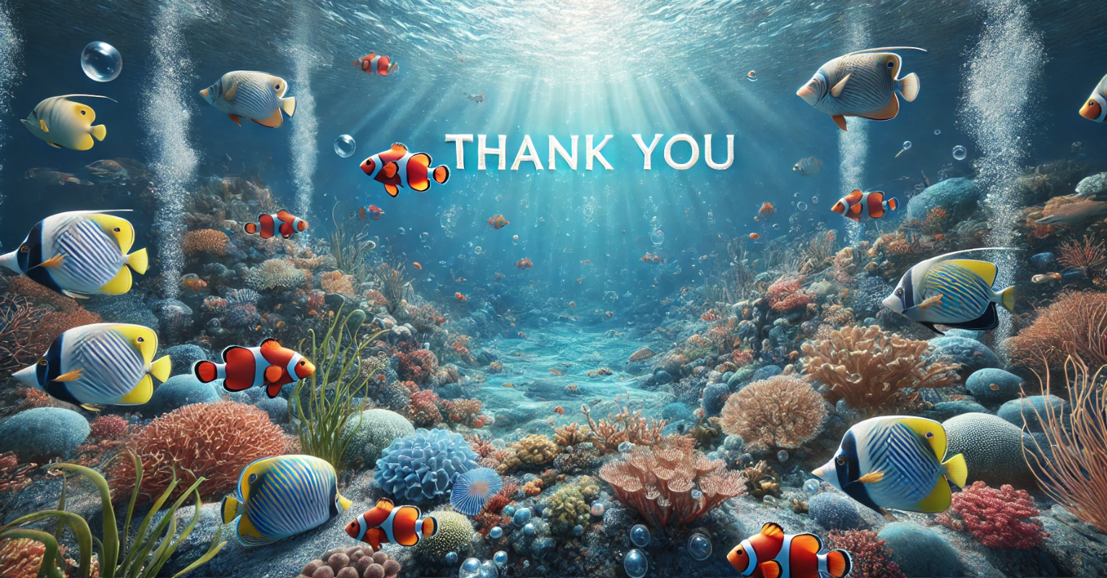
Notes:
So far, we’ve completed the data preparation and preprocessing stages, which involved data collection, cleaning, and transformation.
We’ve also successfully conducted the initial training and evaluation of our enhancement models, and the overall application architecture has been implemented.
Moving forward, our focus will be on deeper training and fine-tuning of the models to improve their performance.
Additionally, we need to work on the integration of the trained models into the main application framework to complete the system.

